Slide 1

Lesson Six Atoms to Electricity
The Harnessed Atom

Slide 2
What you need to know about Atoms to Electricity:
Inside the Reactor
Heat
Pressure
Water
Fission Control
Fuel assemblies
Control rods
Coolant
Pressure vessel
Electricity Generation
Generator
Condenser
Cooling tower
Notes:
Ask students: At what temperature does water boil? (100 degrees C or 212 degrees F)

Slide 3
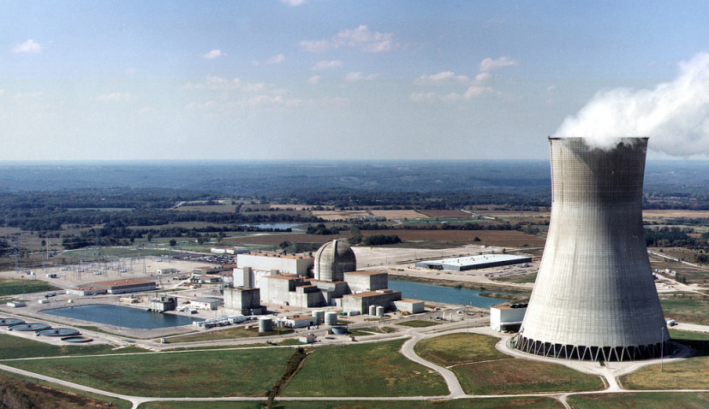
Atoms to electricity
A nuclear reactor is a water heater. Your water heater at home may use electricity or natural gas to heat water. A nuclear reactor uses fissioning uranium-235 atoms to heat water. Water is converted to steam. The steam turns turbines that drive generators to produce electricity.
Notes:
Ask students: How can you tell it is a nuclear power plant? Answer: the dome of the containment building (in the center) and the cooling tower are distinctive. The cloud rising from the cooling tower is water vapor.
Tell students that a nuclear reactor works essentially the same way as a fossil fuel generating plant. Ask them how? Answer: Both heat water to produce steam. The steam turns turbines that drive generators to produce electricity.
Tell students this photo is of the Union Electric--Callaway Plant near Fulton, MO. There are currently 104 licensed to operate nuclear power plants in the United States (69 PWRs and 35 BWRs), which generate about 20% of our nation's electrical use. The one in the photo is a PWR. To find the one nearest you, check out this map of nuclear power plant sites: http://www.nrc.gov/reactors/operating/map-power-reactors.html
Photo from NRC website.

Slide 4
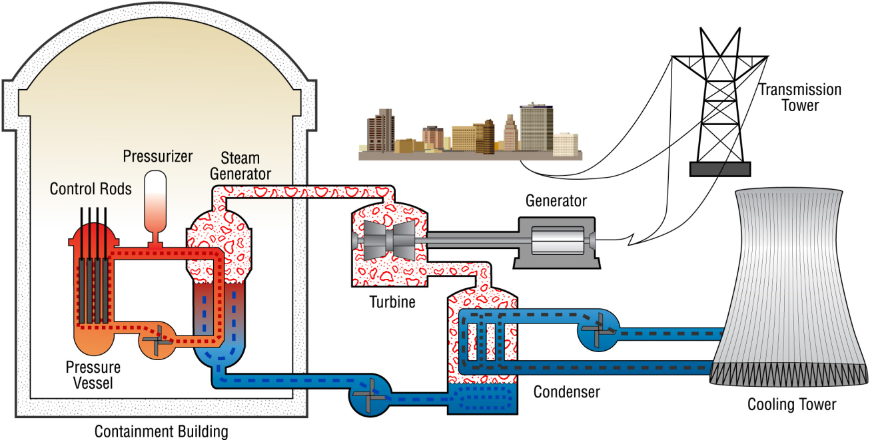
Pressurized water reactor
The steam to run the turbine is produced in a steam generator.
Notes:
The pressurized water reactor differs from the BWR in that the steam to run the turbine is produced in a steam generator. Water boils at 212°F or 100°C. If a lid is tightly placed over a pot of boiling water (a pressure cooker), the pressure inside the pot will increase because the steam cannot escape. As the pressure increases, so does the temperature of the water in the pot. In the PWR plant, a pressurizer keeps the water that is flowing through the reactor vessel under very high pressure to prevent it from boiling. The hot water then flows into the steam generator where it is converted to steam. The steam passes through the turbine which produces electricity. About two-thirds of the reactor power plants in the U.S. are of the PWR type.
Because the United States has more PWRs, we will use PWRs as our example for The Harnessed Atom.
Advantages
PWR reactors are very stable due to their tendency to produce less power as temperatures increase; this makes the reactor easier to operate from a stability standpoint.
PWR turbine cycle loop is separate from the primary loop, so the water in the secondary loop is not contaminated by radioactive materials.
PWRs can passively scram the reactor in the event that offsite power is lost to immediately stop the primary nuclear reaction. The control rods are held by electromagnets and fall by gravity when current is lost; full insertion safely shuts down the primary nuclear reaction.

Slide 5
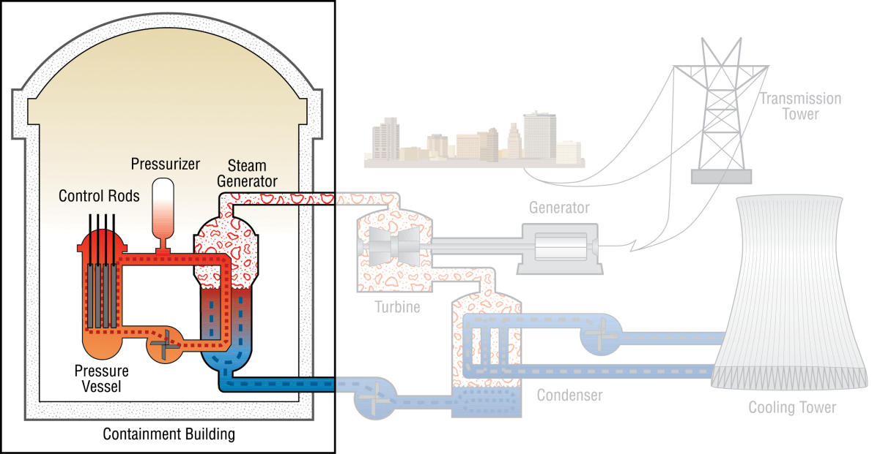
The containment building houses the reactor.
Containment building
Pressure vessel
Notes:
Tell students that under the dome of the containment building is made with thick concrete and steel. This construction is one of the safety features.
In a pressurized water reactor (PWR), the pressurizer controls the water pressure in the reactor so that boiling does not occur. We are using the PWR in this lesson because it works well as an overview of how a nuclear power plant works.
Tell students that the science of how heat moves is called thermodynamics. This scientific law helps us understand how we move the heat energy produced inside the reactor.

Slide 6
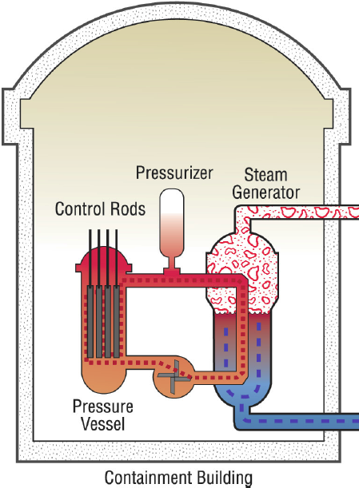
The pressure vessel surrounds the reactor core.
Within the pressure vessel are the uranium fuel assemblies and the control rods. Altogether they form the nuclear core.
The coolant water fills the entire vessel and the loop.
Control rods
Fuel assemblies
Coolant water
Notes:
A nuclear reactor coolant (usually water) acts a moderator. The coolant circulates within the hot reactor core and moderates the heat by absorbing it. The coolant also moderates the neutrons, slowing them down in order to interact with the nuclear fuel and to sustain the chain reaction. In this drawing, the coolant fills the entire orange loop.
The pressure vessel itself is another safety feature. It has walls 22-centimeters (9-inches) thick and weighs 300 tons. It surrounds and protects the nuclear core.

Slide 7
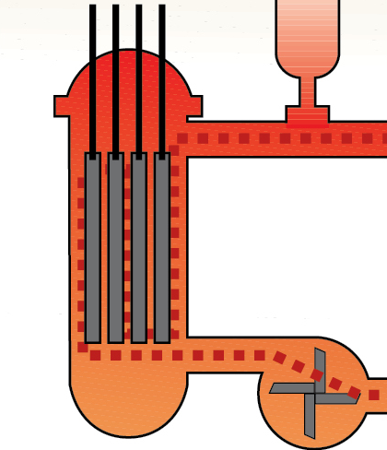
This is where fission happens!
Inside the reactor core, fission takes place within each fuel assembly.
The control rods control the rate of fission.
Control rods
Fuel assemblies
Notes:
A nuclear reactor coolant (usually water) acts a moderator. The coolant circulates the hot reactor core and moderates the heat by absorbing it. The coolant also moderates the neutrons, slowing them down in order to interact with the nuclear fuel and to sustain the chain reaction.
The pressure vessel is another safety feature. It has walls 22-centimeters (9-inches) thick and weighs 300 tons. It surrounds and protects the nuclear core.

Slide 8
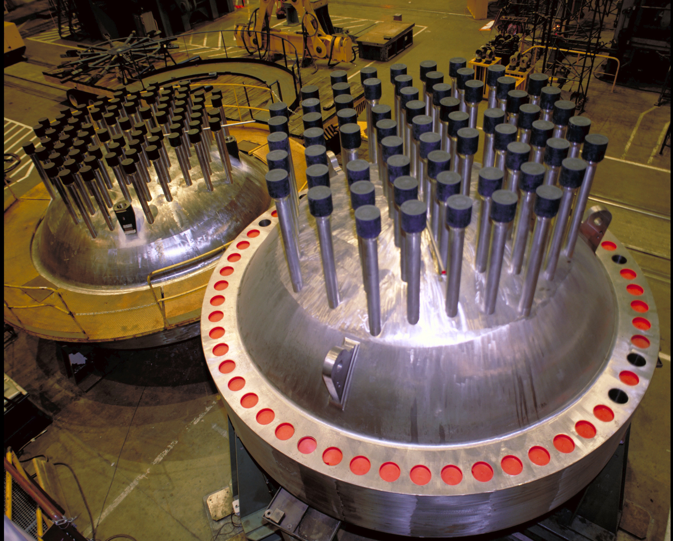
These are the tops of reactor vessels.
The top of the reactor is called the head.
In it are the links to the control rods.
Notes:
Nuclear Regulatory Commission provided this image of pressurized water reactor vessel heads. The NRC regulates the nation's civilian use of nuclear materials to protect public health and safety, defense and security, and the environment. The NRC is headed by five Commissioners appointed by the President of the United States and confirmed by the United States Senate for five-year terms.

Slide 9
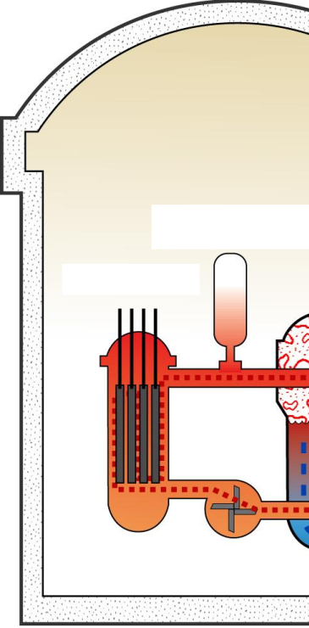
What to remember…
Where’s the containment building?
Where are the fuel assemblies?
Where’s the pressure vessel?
Where are the control rods?
Where’s the coolant water?
E
C
B
D
A
Notes:
Answers:
Containment building is E (the entire building).
Fuel assemblies are B.
Pressure vessel is A.
Control rods are C.
Coolant water is D. (fills the entire pressure vessel and loop)
Bonus Questions: Where is the pressurizer? (to the right of the control rods)

Slide 10
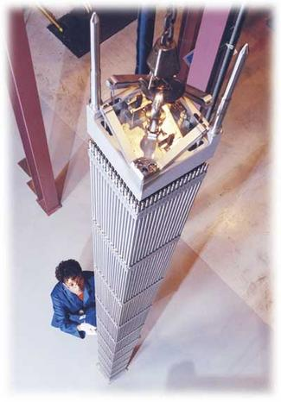
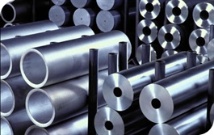
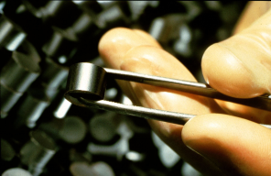
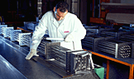
What makes up a fuel assembly?
The fuel is assembled like this:
Fuel pellets
Fuel rods
Fuel assemblies
Notes:
Fuel pellets are stacked inside rods, and the rods are grouped into assemblies.
A single fuel rod cannot generate the heat needed to make the amount of electricity needed by the customers. So fuel rods are carefully bound together in fuel assemblies. The assemblies hold the fuel rods apart so that water can flow between them when they are in the reactor core.
photos are of nuclear fuel from NRC, Westinghouse, and Areva.

Slide 11
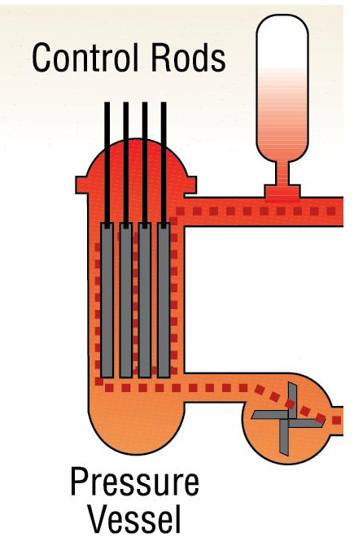
Who controls the control rods?
Power plant operators use control rods to control the speed of the chain reaction.
Moving them out of the reactor starts the reaction. Heat is generated.
Moving them into the reactor slows the reaction. Less heat is generated.
Inserting the control rods all the way shuts down the reaction completely.
The control rods work because they capture neutrons. Captured neutrons cannot cause atoms to fission.
Notes:
Ask students to think back on the mousetrap and ping pong ball “reactor.” What could have slowed down that reaction? Answer: Something blocking the ping pong balls flight. Would all the mousetraps have fissioned with “control rods” in place? Answer: Maybe not.
The paper ball activity would work well to illustrate this concept.

Slide 12
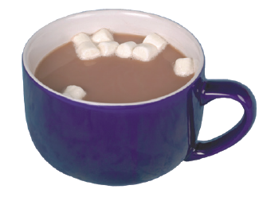
What happens to the heat?
The heat transfers from the reactor core to water in separate loops of piping. The water in the loops never mixes but the heat moves from one to another.
Heat transfer is called thermodynamics. Heat always moves from a warmer to a cooler material, the way heat moves from hot cocoa to the cooler ceramic of the cup.

Slide 13
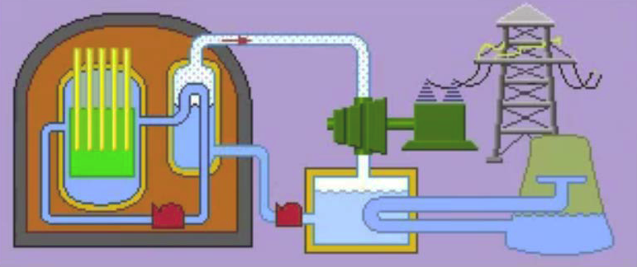
3 Loops with 3 purposes
The three loops in a pressurized water reactor have three purposes.
The three loops are separate. The water in one loop never mixes with the water in another loop. Only the heat energy moves from loop to loop.
Watch this video clip and write down what the three purposes are:
http://www.youtube.com/watch?v=NW9qB2dN_o8&NR=1
Notes:
The clip above runs about 1 minute. Highlight the url with your cursor. Right click from your mouse to select “Open Hyperlink.” Some students may benefit from playing this clip more than one time.
The answers to the 3 purposes are on the 3 slides that follow this one. Here’s a summary:
Water in the first loop is heated by the fission, but doesn’t boil because the water is pressurized. Water stays liquid in the first loop.
In the second loop, the water boils and produces steam (which is a gas). The steam turns turbines which drive generators that produce electricity.
After that the steam cools down and returns to a liquid. We call this condensation. Compare condensation with a “sweating glass” of ice water.

Slide 14
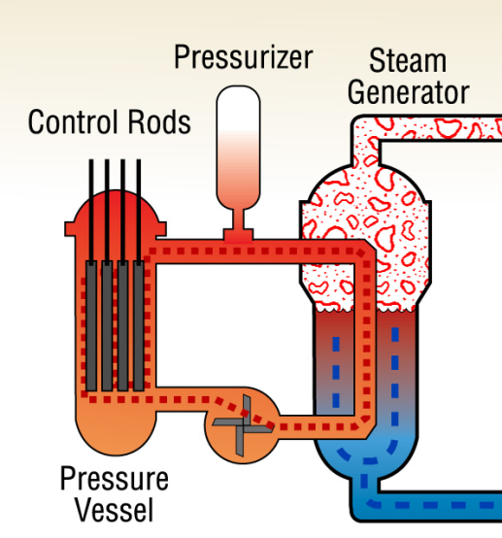
First loop
The first loop carries water heated to a very high temperature in the reactor to the steam-generator.
First loop
Notes:
Ask students why it is important that the water from one loop never mixes with water from another loop. Answer: Separate loops mean that the water from the reactor core does not contaminate the water in the other loops. This is an important radiation safety feature.
Point out that the first loop is pictured here in orange. It could be called a closed loop because it does not exchange outside of the system, as opposed to open loop which does allow exchange.

Slide 15
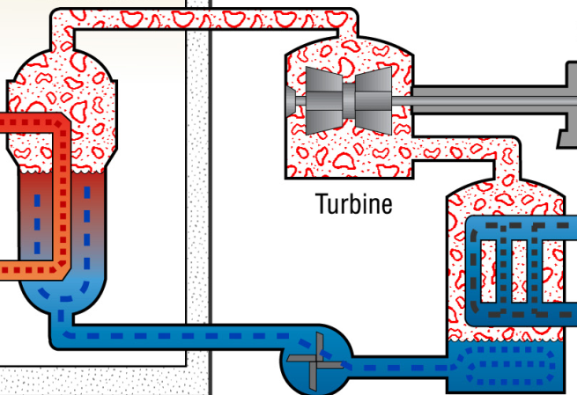
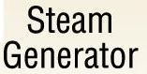
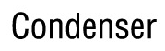
Second loop
The second loop carries the heat energy as steam to the turbines and spins the blades of the turbines.
The turbines are attached to the generators, which change the mechanical energy of the spinning turbine into electricity.
Second loop
Notes:
In the condenser, steam in the second loop is cooled when some of its remaining heat transfers to the water in the third loop. When it is cooled, the steam changes from a gas back into a liquid. Cooled water returns to the steam generator to be reheated. Show students that this loop circulates in a circle.
The second loop is blue and red in this illustration. Blue is the cooled water; red is heated/steam. This is a closed loop also. It is not radioactive.

Slide 16
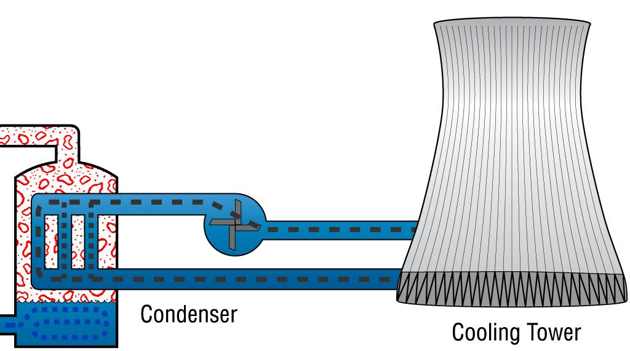
Third loop
The steam is cooled by the condenser, turning it back into a liquid. The third loop contains cooling water drawn from the river. The purpose of the third loop is to cool down the steam in the second loop. The water cools as it drops from high in the cooling tower.
Third loop
Notes:
The condenser loop allows the water to cool and condense as a liquid and return back to the loop. Tell your students that condensation happens all the time: think of a “sweating glass” of ice water or foggy window in a warm house or car on a cold day.

Slide 17
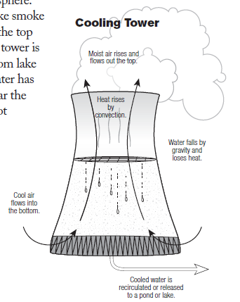
What’s the tallest structure at a power plant?
The 150-meter-tall cooling tower is the power plant’s tallest structure.
Because heated water could harm the environment, water in the third loop is pumped to the cooling tower to fall like rain and cool. Some of the water evaporates and leaves the cooling tower as water vapor. Some is cooled and returned to the river. Most is used again in the third loop.
Notes:
The cooling tower is part of the third loop. Tiles inside the cooling tower are called baffles. They slow the rate of water flow and provide area for cooling. Towers can be up to 200 meters (200 yards) tall and 100 meters (100 yards) in diameter.
The water in the third loop is entirely separate from the second and first loops. It has never been in contact with the reactor core and is not radioactive.

Slide 18
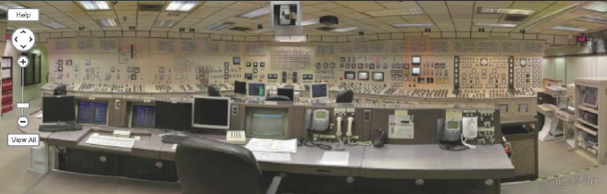
Inside a Control Room
A nuclear power plant’s control room is the “brain” of the plant where operators manage the systems to produce electricity.
Explore the control room at this link:
http://www.pbs.org/wgbh/nova/tech/nuclear-control-room.html
Notes:
Highlight the link above and choose “Open Hyperlink.” Then click the button that says “Launch Interactive” to get to a screen with the control room photo and the option to zone in on different stations. Click on these stations to launch into the panorama. As the screen zooms in, you could ask a student to read aloud the captions at the bottom of the screen.
NRC photo

Slide 19
Summary: Fill in the blanks
The way that nuclear power plants produce heat energy through fission is unique. However, the way the heat energy is changed into electrical energy is basically the same as in a coal or natural gas power plant.
At a nuclear power plant, fission takes place in the reactor.
A reactor has four main parts:
the uranium fuel stacked in fuel assemblies
the control rods
the water coolant
the pressure vessel.
Notes:
The answers are in the sentences above. You can turn this page into an activity using your cursor to highlight the blank spaces. Use your toolbar to make the answers’ font not white.
Review these facts with students before or after a quiz.

Slide 20
Summary (continued)
The fuel assemblies, control rods, and water coolant make up the reactor’s core.
The core is surrounded by the pressure vessel.
The reactor has three separate loops of piping that use water to move heat energy.
Water in these loops never mixes together. However, heat energy moves from one loop to another.
The first loop carries water heated to a very high temperature in the reactor to the steam-generator. In the steam generator, heat energy from the first loop transfers to the second loop.
Notes:
The answers are in the sentences above. You can turn this page into an activity using your cursor to highlight the blank spaces. Use your toolbar to make the answers’ font not white.
Review these facts with students before or after a quiz.

Slide 21
Summary (continued)
The second loop carries the heat energy as steam to the turbines and spins the blades of the turbines.
The turbines are attached to the generators, which change the mechanical energy of the spinning turbine into electricity. From the turbines, steam in the second loop moves to the condenser.
In the condenser, steam in the second loop is cooled when some of its remaining heat transfers to the water in the third loop.
When it is cooled, the steam changes from a gas back into a liquid.
Notes:
The answers are in the sentences above. You can turn this page into an activity using your cursor to highlight the blank spaces. Use your toolbar to make the answers’ font not white.
Review these facts with students before or after a quiz.

Slide 22
Summary (continued)
The third loop contains cooling water drawn from the river. The purpose of the third loop is to remove heat from the steam in the second loop.
When the cooling water in the third loop passes through the condenser, it absorbs heat from the second loop. Water in the third loop is pumped to the cooling tower to have some of its heat removed.
Some of the water evaporates and leaves the cooling tower as water vapor. Some is cooled and returned to the river. Most is used again in the third loop.
A nuclear power plant’s control room is the “brain” of the electricity-producing plant.
Notes:
The answers are in the sentences above. You can turn this page into an activity using your cursor to highlight the blank spaces. Use your toolbar to make the answers’ font not white.
Review these facts with students before or after a quiz.

Slide 23
Interactive Game
Play the game included on this disk to
Power It Up!

Slide 24
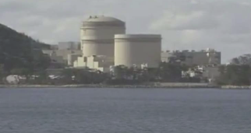
Advanced Student Assignment
This video clip shows how a nuclear power plant works
http://www.youtube.com/watch?v=VJfIbBDR3e8
This video clip says that nuclear energy is carbon free. What does that mean?
Notes:
Answer: Carbon is the byproduct of burning coal, natural gas, petroleum or wood. Nuclear energy is carbon free because it produces no greenhouse gases or air pollutants, other that the steam that rises from the coiling towers. This steam is considered by most scientists to be insignificant. In fact, nuclear energy accounted for 68.9 percent of U.S. emission-free electricity generation in 2010. (per http://www.nei.org/resourcesandstats/nuclear_statistics/environmentemissionsprevented/ )
Pete and Judy: I found this youtube link on the NEI website: http://www.nei.org/howitworks/nuclearpowerplantfuel/. It’s pretty good. I’ve listened/watched a bunch of these and this one is the easiest to understand. Do you think this slide’s placement is correct? Should it be optional?

Slide 25
Lesson 6 Vocabulary
baffles – tiles inside the cooling tower at a nuclear power plant that slow the rate of water flow and provide area for cooling
boron – a non-metallic element used in the control rods and coolant water in nuclear reactors to absorb neutrons and, thus, help control the rate of fission; symbol is B
cadmium – a soft, bluish-white metallic element that is used in control rods in nuclear reactors to absorb neutrons and, thus, help control the rate of fission; symbol is Cd
condenser – the equipment at a nuclear power plant that cools steam and turns it back into water
containment – the action of keeping something under control or within limits

Slide 26
Vocabulary
containment building – a large building of steel-reinforced concrete that surrounds and protects the reactor and also protects the environment
control rods – devices that can be pulled out of and inserted into the reactor core to absorb neutrons and regulate the chain reaction; used to control the speed of a chain reaction
coolant – a substance used for cooling
coolant/moderator – a substance used to cool the reactor and to slow neutrons. In most nuclear power plants, water is used to keep the reactor from getting too hot and also slow the neutrons down so they are more likely to cause uranium-235 atoms to fission.
cooling tower – a structure in a nuclear power plant used to remove heat from cooling water; prevents thermal pollution of lakes and rivers

Slide 27
Vocabulary
fuel assembly – structure containing fuel rods that hold stacked uranium pellets; bundles of fuel rods that are loaded in the reactor core
generator – a machine that makes electricity
heat transfer – the movement of heat from a hotter object to a cooler object; the transfer can be made by conduction, convection, or radiation
moderator – a substance that slows neutrons down in the reactor so they are more likely to cause uranium atoms to fission. In U.S. reactors, the moderator is water.
pressure – the effect of a force applied to a surface. Keeping water under pressure in the reactor of a pressurized water reactor means the water can be heated to a temperature greater than 100ºC or 212ºF without boiling.

Slide 28
Vocabulary
pressure vessel – an extremely strong steel container that surrounds the core of the nuclear reactor; may also be called the reactor vessel
pressurized water reactor (PWR) – a type of nuclear reactor in which water is kept under pressure in the reactor core so that the water can be heated to a temperature greater than 100ºC or 212ºF without boiling
reactor – the part of a nuclear power plant where fission takes place
steam-generator – a machine that uses heat in a power plant to produce steam to turn turbines
thermodynamics – the science of the way heat transfers or moves
turbine - a wheel with many blades that are spun and connected to a generator to make electricity

Slide 29
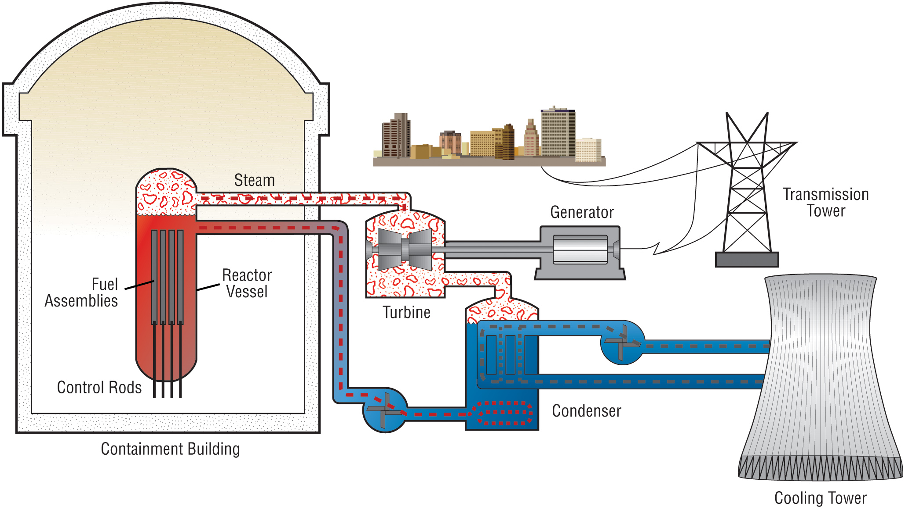
For discussion: Two main types of nuclear power plants
Boiling Water Reactor (BWR)
The reactor water boils to produce steam. Two loops, control rods enter from bottom.
Pressurized Water Reactor (PWR)
The reactor water is under pressure and does not boil.
Water from the reactor heats pipes in a steam generator. Water that is turned into steam never mixes with the water in the first loop.
Notes:
Ask students to find the physical differences in these two pictures. Main differences: 1.) Steam is in BWR reactor vessel and not in the PWR vessel. 2.) The control rods are usually managed from the bottom of a BWR and the top of a PWR.
Tell students that pressurized water reactors are the most common reactors in the United States. The PWR was originally designed for propelling nuclear submarines. There are 35 BWRs in the U.S. today and nearly twice as many PWRs. Ask students if they can guess why. (Answer: PWRs are safer.)

Slide 30
Boiling water reactor
The steam rises to the top of the pressure vessel and is sent to the generator to turn the turbine.
Notes:
Ask students how they can tell this is a nuclear power plant. The dome of the containment building gives it away.
The boiling water reactor operates in essentially the same way as a fossil fuel generating plant. Water in the BWR boils inside the pressure vessel and steam is produced when very pure water (reactor coolant) moves upward through the core absorbing heat. The water boils and produces steam. When the steam rises to the top of the pressure vessel, water droplets are removed, the steam is sent to the turbine generator to turn the turbine.
The Fukushima Dai ichi (dai ichi means number one) Nuclear Power Plant is a BWR.

